Slide 1
Boolean Retrieval Model

Slide 2
A First Information Retrieval
Example
Ad hoc retrieval: Find documents in a collection of documents (corpus), relevant to a certain user need
Boolean retrieval model: Model in which queries are posed as Boolean expressions
Example: Shakespeare
  • Find all Shakespeare plays that contain the words
  BRUTUS AND CAESAR AND NOT CALPURNIA

Slide 3
BRUTE Force Approach
One could grep all of Shakespeare’s plays for BRUTUS and CAESAR, then strip out plays containing CALPURNIA
  Unix command grep, linear search
Why is that not the answer?
  Slow (for large corpora)
  NOT Calpurnia is non-trivial
  Other operations (e.g., find the word ROMANS NEAR COUNTRYMEN) not feasible
  Ranked retrieval (best documents to return)
Instead, organize beforehand

Slide 4
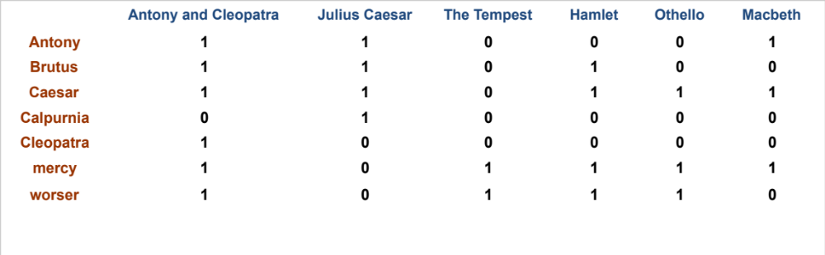
Term-document incidence matrices
Sec. 1.1
1 if play contains word, 0 otherwise
Brutus AND Caesar BUT NOT Calpurnia

Slide 5
Incidence vectors
Sec. 1.1
So we have a 0/1 vector for each term.
To answer query: take the vectors for Brutus, Caesar and Calpurnia (complemented) ➔ bitwise AND.
  110100 AND
  110111 AND
  101111 =
  100100

Slide 6
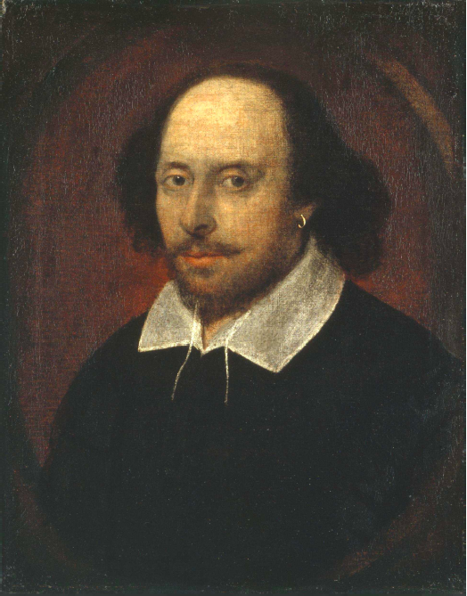
Answers to query
Sec. 1.1
Antony and Cleopatra, Act III, Scene ii
Agrippa [Aside to DOMITIUS ENOBARBUS]: Why, Enobarbus,
When Antony found Julius Caesar dead,
He cried almost to roaring; and he wept
When at Philippi he found Brutus slain.
Hamlet, Act III, Scene ii
Lord Polonius: I did enact Julius Caesar I was killed i’ the
Capitol; Brutus killed me.
Notes:
Wikimedia commons picture of Shake

Slide 7
Bigger collections
Sec. 1.1
Consider N = 1 million documents, each with about 1000 words.
Avg 6 bytes/word including spaces/punctuation
  6GB of data in the documents.
Say there are M = 500K distinct terms among these.

Slide 8
Can’t build the matrix
Sec. 1.1
500K x 1M matrix has half-a-trillion 0’s and 1’s.
But it has no more than one billion 1’s.
  matrix is extremely sparse.
What’s a better representation?
  We only record the 1 positions.
Why?
Notes:
Why?
1000/500 000=1/500 --- ones in each document vector
1/500 * 500 000* 1 M =1000 * 1 M= 1 billion

Slide 9
The Inverted Index
The key data structure underlying modern IR

Slide 10
Inverted index
Sec. 1.2
For each term t, we must store a list of all documents that contain t.
  Identify each doc by a docID, a document serial number
Can we used fixed-size arrays for this?
Brutus
1
2
4
11
31
45
173
174
Caesar
1
2
4
5
6
16
57
132
Calpurnia
2
31
54
101
What happens if the word Caesar is added to document 14?

Slide 11
Inverted index
Sec. 1.2
We need variable-size postings lists
  On disk, a continuous run of postings is normal and best
  In memory, can use linked lists or variable length arrays
    Some tradeoffs in size/ease of insertion
Posting
Brutus
1
2
4
11
31
45
173
174
Caesar
1
2
4
5
6
16
57
132
Calpurnia
2
31
54
101
Dictionary
Postings
Sorted by docID (more later on why).
Notes:
Linked lists generally preferred to arrays
Dynamic space allocation
Insertion of terms into documents easy BUT Space overhead of pointers
Variable length arrays
win in space requirements by avoiding the overhead for pointers and in
time requirements because their use of contiguous memory increases speed
on modern processors with memory caches.

Slide 12

Inverted index construction
Sec. 1.2
Documents to
be indexed
Friends Romans countrymen.
Tokenizer
Token stream
Friends
Romans
Countrymen
Linguistic modules
Modified tokens
friend
roman
countryman
Indexer
friend
2
4
roman
1
2
Inverted index
countryman
2
16
Notes:
Document icons from free icon set: http://www.icojoy.com/articles/44/

Slide 13
Initial stages of text processing
Tokenization
  Cut character sequence into word tokens
    Deal with “John’s”, a state-of-the-art solution
Normalization
  Map text and query term to same form
    You want U.S.A. and USA to match
Stemming
  We may wish different forms of a root to match
    authorize, authorization
Stop words
  We may omit very common words (or not)
    the, a, to, of

Slide 14

Indexer steps: Token sequence
Sec. 1.2
Sequence of (Modified token, Document ID) pairs.
Doc 1
Doc 2
I did enact Julius
Caesar I was killed
i’ the Capitol;
Brutus killed me.
So let it be with
Caesar. The noble
Brutus hath told you
Caesar was ambitious

Slide 15

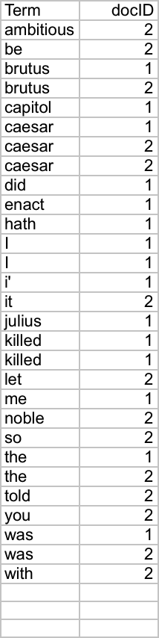
Indexer steps: Sort
Sec. 1.2
Sort by terms
  And then docID
Core indexing step

Slide 16

Indexer steps: Dictionary & Postings
Sec. 1.2
Multiple term entries in a single document are merged.
Split into Dictionary and Postings
Doc. frequency information is added.
Why frequency?
Will discuss later.

Slide 17
Where do we pay in storage?
Sec. 1.2
Lists of docIDs
Terms and counts
IR system implementation
How do we index efficiently?
How much storage do we need?
Pointers

Slide 18
Query processing with an inverted index

Slide 19
The index we just built
Sec. 1.3
How do we process a query?
  Later - what kinds of queries can we process?
Our focus

Slide 20
Query processing: AND
Sec. 1.3
Consider processing the query:
  Brutus AND Caesar
  Locate Brutus in the Dictionary;
    Retrieve its postings.
  Locate Caesar in the Dictionary;
    Retrieve its postings.
  “Merge” the two postings (intersect the document sets):
2
4
8
16
32
64
128
Brutus
1
2
3
5
8
13
21
34
Caesar

Slide 21
The merge
Sec. 1.3
Walk through the two postings simultaneously, in time linear in the total number of postings entries
2
4
8
16
32
64
128
Brutus
1
2
3
5
8
13
21
34
Caesar
If the list lengths are x and y, the merge takes O(x+y)
operations.
Crucial: postings sorted by docID.

Slide 22

Intersecting two postings lists
(a “merge” algorithm)

Slide 23
The Boolean Retrieval Model
& Extended Boolean Models

Slide 24
Boolean queries: Exact match
Sec. 1.3
The Boolean retrieval model is being able to ask a query that is a Boolean expression:
  Boolean Queries are queries using AND, OR and NOT to join query terms
    Views each document as a set of words
    Is precise: document matches condition or not.
  Perhaps the simplest model to build an IR system
Primary commercial retrieval tool for 3 decades.
Many search systems you still use are Boolean:
  Email, library catalog, Mac OS X Spotlight

Slide 25
Example: WestLaw http://www.westlaw.com/
Sec. 1.4
Largest commercial (paying subscribers) legal search service (started 1975; ranking added 1992; new federated search added 2010)
Tens of terabytes of data; ~700,000 users
Majority of users still use boolean queries
Example query:
  What is the statute of limitations in cases involving the federal tort claims act?
  LIMIT! /3 STATUTE ACTION /S FEDERAL /2 TORT /3 CLAIM
    /3 = within 3 words, /S = in same sentence

Slide 26
Example: WestLaw http://www.westlaw.com/
Sec. 1.4
Another example query:
  Requirements for disabled people to be able to access a workplace
  disabl! /p access! /s work-site work-place (employment /3 place
Note that SPACE is disjunction, not conjunction!
Long, precise queries; proximity operators; incrementally developed; not like web search
Many professional searchers still like Boolean search
  You know exactly what you are getting
But that doesn’t mean it actually works better….

Slide 27
Query optimization
Sec. 1.3
What is the best order for query processing?
Consider a query that is an AND of n terms.
For each of the n terms, get its postings, then AND them together.
Brutus
2
4
8
16
32
64
128
Caesar
1
2
3
5
8
16
21
34
Calpurnia
13
16
Query: Brutus AND Calpurnia AND Caesar

Slide 28
Query optimization example
Sec. 1.3
Process in order of increasing freq:
  start with smallest set, then keep cutting further.
This is why we kept
document freq. in dictionary
Brutus
2
4
8
16
32
64
128
Caesar
1
2
3
5
8
16
21
34
Calpurnia
13
16
Execute the query as (Calpurnia AND Brutus) AND Caesar.

Slide 29
More general optimization
Sec. 1.3
e.g., (madding OR crowd) AND (ignoble OR strife)
Get doc. freq.’s for all terms.
Estimate the size of each OR by the sum of its doc. freq.’s (conservative).
Process in increasing order of OR sizes.

Slide 30
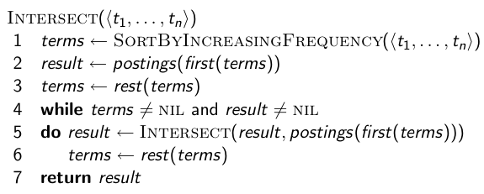
Optimized intersection algorithm for
conjunctive queries

Slide 31
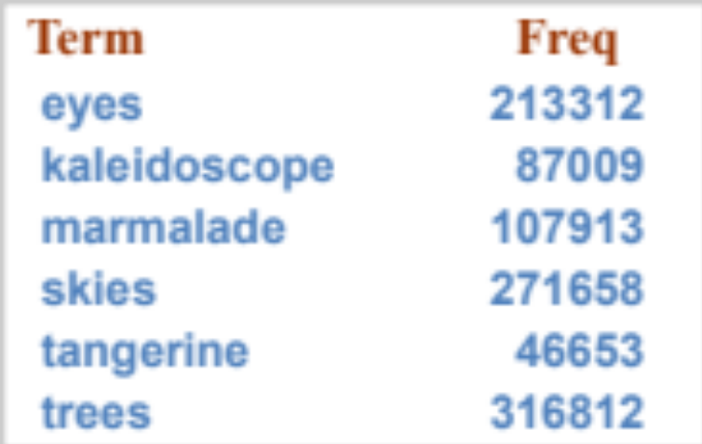
Exercise
Recommend a query processing order for
Which two terms should we process first?
(tangerine OR trees) AND
(marmalade OR skies) AND
(kaleidoscope OR eyes)

